Slide 1
Cyber Security and Local Health and Care Record (LHCR) Update NYHDIF – 14 September 2018
Paul Barnes - Cyber Security Programme Manager,
NHS England

Slide 2
SESSION OVERVIEW
Briefing with Q & A
Cyber Security in the NHS
Regulatory and policy landscape
7 Key principles to manage cyber security
Assurance
NHS England cyber security programme workstreams
Local Health & Care Record update

Slide 3
CYBER ATTACKS IN HEALTH AND CARE: THE UN-RECOGNISED GLOBAL TARGET
Since 2013 the health and care sector has increasingly been targeted by a variety of cyber threat actors, driven by a variety of motives and utilising a number of techniques
£
Healthcare accounted for 88% of Ransomware attacks in 2016
£9.1m average cost of cyber crime in healthcare sector globally in 2017
PII data is 64% more expensive than the most valuable financial data on the black-market
~34.5% of all personnel records breached in 2016 were healthcare related*
In October 2016, the World Medical Association stated that healthcare is becoming more susceptible to data breaches and attacks. Largely due to lack of investment and resiliency at a local level, lack of workforce awareness and a decentralised system without a single competent authority to prescribe or enforce meaningful security standards and capabilities.
*This does not take account of the Yahoo breach which was reported in 2016 as this occurred in 2013.

Slide 4
THE REGULATORY & POLICY LANDSCAPE: CURRENT & EMERGING
Her Majesty’s Government
GCHQ
National Cyber Security Centre
National Crime Agency
Home Office
Department of Health and Social Care:
Oversees Cyber Security resilience and incident responses in healthcare
POLICY, GUIDANCE & SECURITY CAPABILITY DELIVERY
NIB: Leadership on IT
NHS England: Provides information on cyber to CCGs & embeds Cyber standards
NHS Digital: Works with local healthcare to understand / advise on cyber security requirements
NHS Improvement: Communicates information about cyber to trusts/healthcare providers
Care Quality Commission: Assesses/regulates safety of patient care including data security
NDG: Independent advisory on data
209 Clinical Commissioning Groups: Responsible for following standards set by the department / protecting the data in line with GDPR
44 Sustainability & Transformation Partnerships,
14 Integrated Care Systems: Constituent orgs include Local Authorities / CCGs / Providers
235 NHS Trusts and NHS foundation trusts: Responsible for following standards set by the department / having arrangements in place for incidence response
IMPLEMENTATION, COMPLIANCE & LO CAL MANAGEMENT

Slide 5
WELL-LED FRAMEWORK: WELL-ESTABLISHED AND UNDERSTOOD FRAMEWORK
The well-led framework is structured around eight key lines of enquiry (KLOEs).
1
2
3
Is there the leadership capacity and capability to deliver high quality, sustainable care?
Is there a clear vision and credible strategy to deliver high quality, sustainable care to people, and robust plans to deliver?
Is there a culture of high quality, sustainable care?
4
5
Are there clear responsibilities, roles and systems of accountability to support good governance and management?
Are services well led?
Are there clear and effective processes for managing risks, issues and performance?
6
7
8
Is appropriate and accurate information being effectively processed, challenged and acted on?
Are the people, who use services, the public, staff and external partners engaged and involved to support high quality sustainable services?
Are there robust systems and processes for learning, continuous improvement and innovation?

Slide 6
WELL-LED FRAMEWORK: WELL-ESTABLISHED AND UNDERSTOOD FRAMEWORK
The Cyber Security approach is aligned to the framework.
1
2
3
Enable leadership to have transparency of progress in cyber security, areas of risk, and areas of high performance.
The strategy must be informed by the metrics provided through audit.
Creating a culture of improvement and knowledge sharing across CCG and STPs to share cyber lessons learnt.
4
5
Identifying roles and responsibilities and providing information relevant to specific stakeholders.
Are services well led?
Common Cyber Security reporting metrics across the NHS.
6
7
8
Evidence based metrics support accurate information that can be acted on.
Audit can act as the communication mechanism between local IT departments, local leadership, and the wider NHS ecosystem.
Auditing performance with evidence based metrics enables improvement and identification of improvement areas.

Slide 7
SUSTAINABLE CYBER SECURITY: BUILT ON INDUSTRY & LEADING PRACTICES
The framework must be aligned to the specific obligations and objectives of national and internal Health and Care best practices.
ISO27001/2: Specification framework for development and assessment of Information Management systems
ISO31000: Is a Risk management principle-based framework that provides a process for managing risk
ISF Good Practice for Information Security: Business orientated information security controls framework & guidance
DATA IS USED SAFELY & SECURELY
NCSC Guidance notes: relevant ad-hoc guidance and advice for UK CNI & Government entities
Alignment to NHS Digital Information Security, Risk Management & Code of Practice
General Data Protection Regulation GDPR Adherence: relevant provision of safeguarding of personal data
Well-Led Framework: organisation wide framework for managing digital change including security
COBIT 5: Governance orientated globally recognised framework and a focus on maturity models

Slide 8
SUSTAINABLE CYBER SECURITY: SEVEN KEY PRINCIPLES
A comprehensive framework is required to develop a sustainable and proportionate approach to strategically manage Cyber Security.
Proportionate Investment
Leadership, Governance, & Culture
Effectiveness & efficiency of Cyber Security expenditure for increasing quality of healthcare provision for patients
Effectiveness of cyber security as an integral part of corporate governance and culture. Supporting staff to make secure decisions
Improving Clinical Quality and Efficiency
Business Continuity
- Effective Cyber Response
Effectiveness of aligning patient outcomes and needs with security threats and risks Alignment to clinical care strategy.
Organisation focused effectiveness review of resilience & response processes to threat
DATA IS USED SAFELY & SECURELY
Assuring Processes & Controls
Enabling Service Integration
Effectiveness of patient data security controls and related process
Confidence in security practices of your partners, third parties, service providers and employees
Understand Key Threats
Identification of current & potential cyber threats specific to health & the NHS

Slide 9
SCENARIO 1: INTEGRATED CARE PATHWAYS - WHAT QUESTIONS SHOULD YOU BE ASKING TO ASSURE SECURITY?
The seven key principles can be used to form the basis of the questions the board should be asking to assure the security of a project like Integrated Care Pathways.
Proportionate Investment
Leadership, Governance, & Culture
16. What % of the integrated pathway budget is spent on security?
17. Which identified key threats is this spend mitigating?
1. Who on the board is accountable for the security of the Integrated care pathway project at each point/organisation in the integrated care pathway
2. Which organisation is responsible for the delivery of the security across the entire complete pathway?
Business Continuity
- Effective Cyber Response
Improving Clinical Quality and Efficiency
14. How and where is the patient data backed up, centrally or at each point in the pathway?
15. Is there a contract in place between organisations on the care pathway detailing an incident response process?
3. Have we considered the security implications that support us in meeting our clinical priorities?
4. Are the appropriate staff at each point in the pathway authorised to access the data required to provide care?
5. How is access managed (including SML processes) across the pathway and at each point in the pathway?
DATA IS USED SAFELY & SECURELY
Assuring Processes & Controls
Enabling Service Integration
12. What PII data is transferred between each point in the integrated pathway?
13. Is data encrypted at rest and in transit between points in the pathway?
6. Have we identified the risks across connecting organisations, and the mitigating actions needed to manage those risks?
7. How many third party technologies does the solution integrate with?
8. Have all these third parties been through a security maturity review as part of the procurement onboarding?
9. Does any point in the pathway expose the patient data to additional third parties?
Understand Key Threats
10. Is external threat intelligence being used to inform the security risks?
11. Are the integrated pathway systems logs being reviewed for incidents in a SOC?

Slide 10
The NHS England Cyber Programme
Contractual & Regulatory Framework
Addressing Infrastructure Weakness
Communications & Engagement
Local Performance & Capability
Threat Surveillance & Incident Response

Slide 11
Workstream | Current / upcoming activity
Contractual & Regulatory Framework | Supported regional GP IT Events across all 4 regions (July/August) Reviewing responses to Data and Security Protection Requirements (DSPR) (July/August) Escalations under Network & Information Systems Regulations (NIS)
Addressing Infrastructure Weakness | Following up on 2017/18 capital funding allocation (August) Supporting NHS Digital to develop “Local Interventions” pilot sites 2018/19 capital funding (October onwards)
Communications & Engagement | Joining up with NHS D Board level GCHQ accredited training to NHS Trusts, to signpost NHS E work Developed Board level framework for managing cyber – 7 principles and deliver sessions for Trust Boards, STP Boards CCG Audit Chairs – engagement and testing of materials with advisory group (July – Oct)
Local Performance & Capability | On-site assessments – created priority list for 2018/19 assessments Follow up on outcomes from CSU deep dives
Threat Surveillance & Incident Response | Document pre-incident management processes and communication protocols Support the development of CareCERT Collect portal, including reporting

Slide 12
Network & Information Systems (NIS) Regulations 2018
Background:
Came into force on 10 May 2018
To ensure that ‘essential services’ have adequate data and cyber security measures in place
Requires ‘operators of essential services’ to take appropriate and proportionate measures to:
- manage risks to security of networks;
- prevent and minimise the impact of incidents; and
- report serious incidents.
Overseen by ‘Competent Authority’ – DHSC

Slide 13
Network & Information Systems (NIS) Regulations 2018
The DHSC has aligned NIS with existing cyber security programme, tools and mechanisms
Compliance will be measured via:
- Data Security and Protection Toolkit (DSPT)
- On-site Assessments
- Other data (e.g. DSPR responses)
- Toolkit incorporates IG, NDG, NIS and GDPR
Further guidance: https://www.gov.uk/government/publications/network-and-information-systems-regulations-2018-health-sector-guide

Slide 14
Network & Information Systems (NIS) Regulations 2018
What you should do:
Ensure the ten steps set out in the DSPR have been implemented
Sign up for the DSP Toolkit
Book an on-site assessment with NHS Digital
Develop a plan to achieve Cyber Essentials Plus by June 2021
Complete an interim DSPT return in October
Report GDPR and NIS incidents through the incident notification tool
For questions about the application of the NIS regulations please contact NIS.Authority@dh.gsi.gov.uk

Slide 15
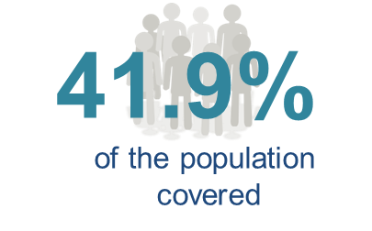
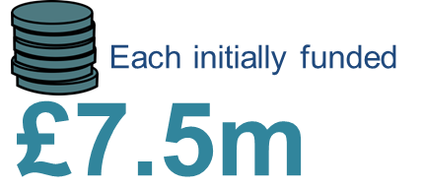
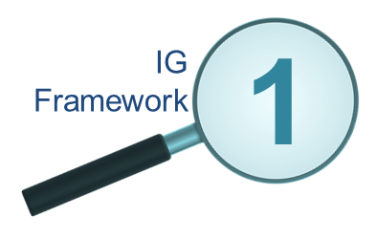
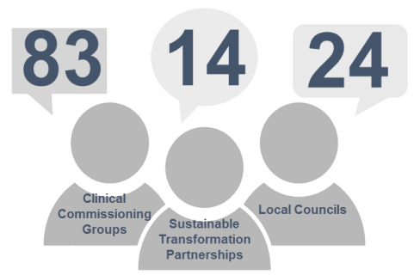
Local Health & Care Records – the story so far…
5
Wave 1
Exemplars
Greater Manchester
The Greater Manchester devolution patch
Pop. 2.8m
Exemplars
engage with…
Yorkshire & Humber
West Yorkshire, South Yorkshire & Bassetlaw, Humberside and North Yorkshire
Pop. 5.4m
One London
All of London
Pop. 8.5m
Thames Valley & Surrey
Buckinghamshire, Berkshire, Oxfordshire and Surrey
Pop. 3.2m
Wessex
Hampshire, Isle of Wight and Dorset
Pop. 2.6m

Slide 16
LHCR & Cyber
Exemplars required to assure the security status of connections
Must comply with the 10 data security standards set by the National Data Guardian
NHS E is working with the National Cyber Security Centre and Department of Health and Social Care to develop ‘attack tree risk’ approach
Attack Tree risk workshops are being specifically designed for LHCR areas
Aim is to map out risks and the mitigation of those risks
Workshops to be held during October and November

Slide 17
LHCR - Cyber Security approach
2. Attack-tree sessions–
for each LHCRE to identify threats and mitigations
3. Focus - Hardening of the data layer and APIs to connected systems
1. Using the NCSC- recommended approach – for “complex systems”
4. Consolidated set of mitigations = LHCR Cyber standard
Iterate
Notes:
NCSC session already held with GM and other LHCREs to be lined up over Autumn.
This then defining the “standard” needed which LHCRs will then implement

Slide 18
Contact details
Specific queries:
Paul.barnes1@nhs.net
General queries and feedback:
England.cyber@nhs.net

